Slide 1
Forecast Use of a City Bike-sharing System (Washington, D.C.)
Data Cleaning
Factor Analysis
Multiple Regression

Slide 2
Bike Sharing Demand Analysis
Introduction
Multiple Regression
Data Set Limit
Data Cleaning
Appendix

Slide 3
Introduction
Bike sharing systems function as network, which can be used for studying mobility in a city.
10886 cases in different time were recorded to combine historical usage patterns with weather, in order to forecast bike rental demand in the Capital Bike sharing program in Washington, D.C.

Slide 4
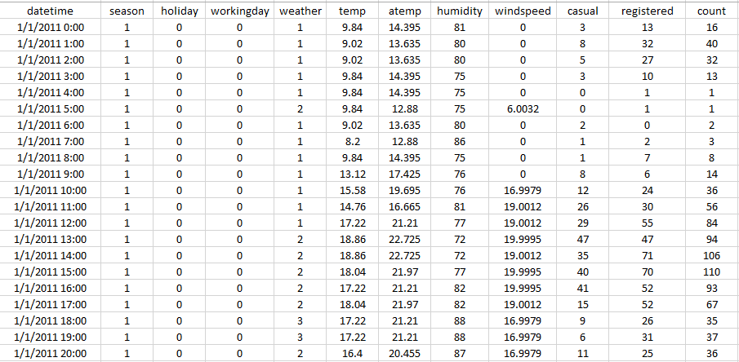
A Quick Look of Original Data Set

Slide 5
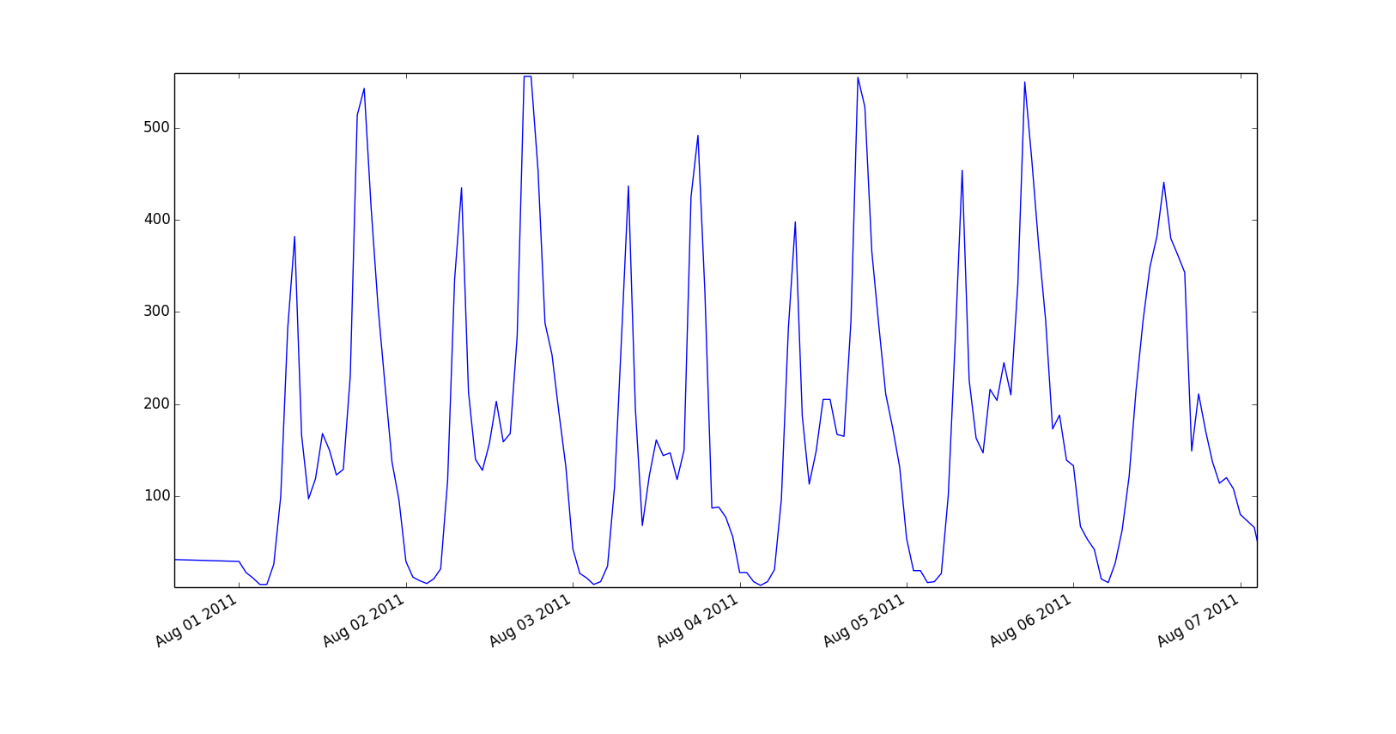
Examining the Data: A weeks worth of data

Slide 6
Bike Sharing Demand Analysis
Introduction
Multiple Regression
Data Set Limit
Data Cleaning
Appendix

Slide 7
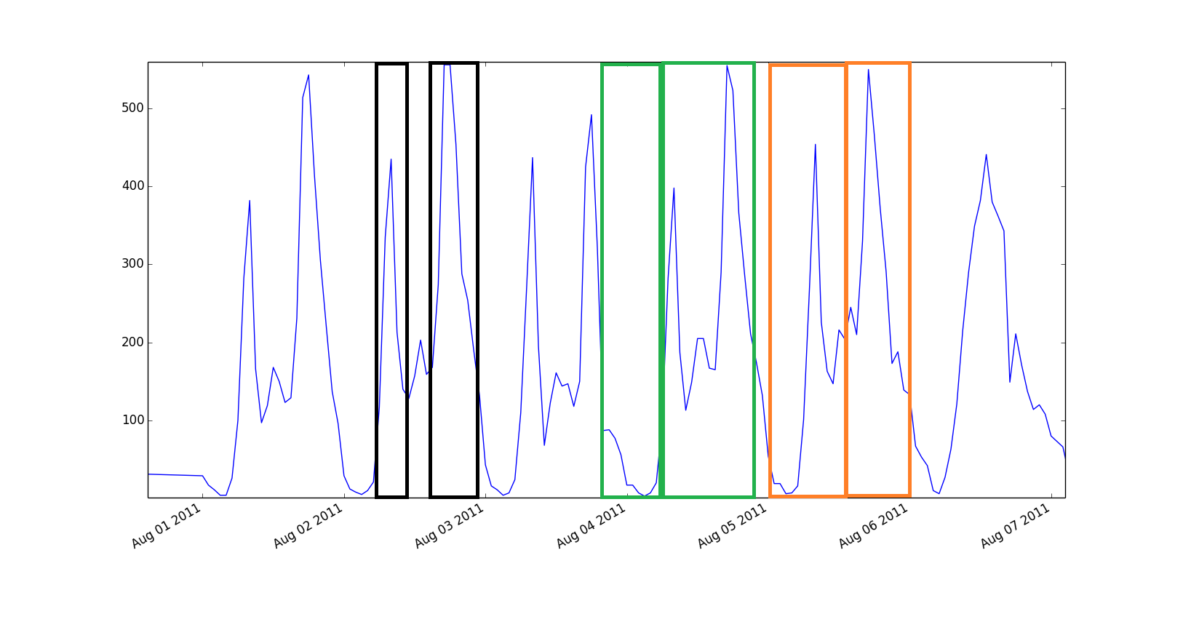
Processing the Data
In order to capture the impact of weekday, and time of day on the data several dummy variables were created:
Converted Season and Weather to sets of binary dummy variables
Rush hour
Daytime
AM/PM

Slide 8
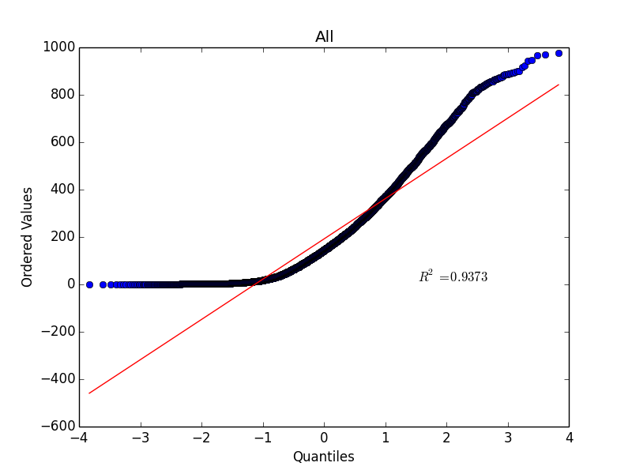
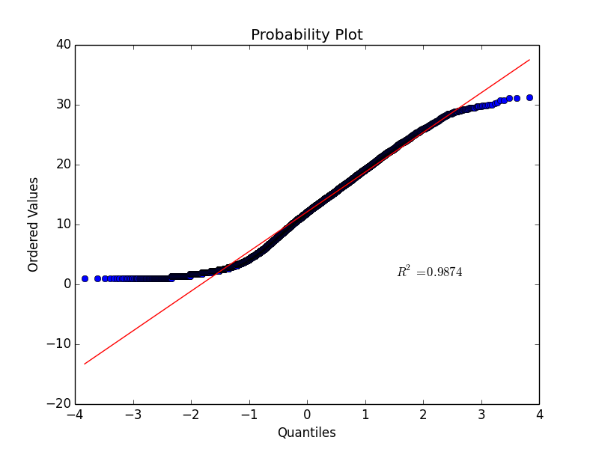
Data Normality
Before
Count of bicycles in use follows Exponential distribution rather than normal distribution
Transformed into sqrt(count) to enforce normality
After

Slide 9
Bike Sharing Demand Analysis
Introduction
Multiple Regression
Data Set Limit
Data Cleaning
Appendix

Slide 10
Multiple Regression of Bike Sharing Demand
Step 1 Problem Description
Step 2 Summary & Conclusion
Step 3 Analysis & Results
Step 4 Recommendation
Discussion

Slide 11
Problem Description- Multiple Regression
Use Weather and Time-related variables to predict and explain Sum Count of Casual and Registered Users.
Weather and Time-related variables
Season
Holiday
Working day
Weather
Temp
Atemp
Humidity
Wind speed
AM/PM
Rush hour
Sum Count
Count

Slide 12
Convert Categorical Variables to Dummy Variables
Season
1-4
Season 1
Season 2
Season 3
0-1
Weather
1-4
Weather 1
Weather 2
Weather 3
0-1

Slide 13
Problem Description- Multiple Regression
Weather and Time-related variables
Holiday
Working day
Temp
Atemp
Humidity
Wind speed
AM/PM
Rush hour
Season 1
Season 2
Season 3
Weather 1
Weather 2
Weather 3
Predict and Explain
Sum Count
Count

Slide 14
Summary & Conclusion- Multiple Regression
Count can be accurately explained and predicted by holiday, working day, temp, atemp, humidity, wind speed, rush hour, weekend, daytime, AM/PM, season 1, season 2, season 3, and weather 3.
Count = 9.921 - 0.583 Holiday – 0.358 Working Day + 0.147 Temp + 0.094 Atemp – 0.038 Humidity – 0.021 Wind Speed + 4.384 Rush Hour + 1.094 Weekend + 4.051 Daytime – 4.927 AM/PM – 2.569 Season 1 – 1.247 Season 2 – 1.870 Season 3 -2.41 Weather 3

Slide 15
Analysis & Results- Multiple Regression
Best fit single independent variable
Regression model selected from a Stepwise Regression Analysis
Tests for Multiple Regression Analysis assumptions
Model’s Multicollinearity

Slide 16
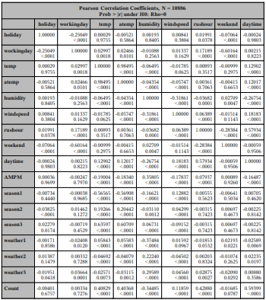
1. Best fit single independent variable
Considered the Correlation Analysis and simple regression,
Daytime fits the best as a predictor to Count.

Slide 17
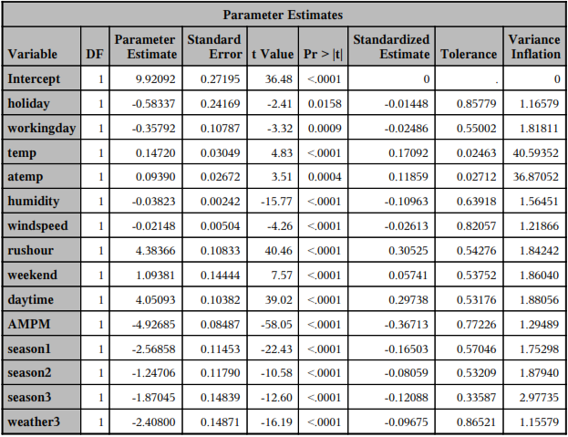

2. Regression model selected
Stepwise Regression Analysis
According to adjust R-Sq, 66.38% of Count can be explained; and error rate at the 95% confidence level is about 0.

Slide 18
3. Test for multiple regression assumption
Linearity
Normality
Independence
Homoscedasticity
Variable count has been convert
the residuals represent a normal distribution
Linear pattern- residual plots
Low correlation between independent variables
Residual analysis shows homoscedastic

Slide 19
4. Model’s multicollinearity
Selected regression model shows multicollinearity in some dimensions
Time series dimension: holiday, rush hour, weekend, daytime
Season dimension: season 1, season 2, and season 3
Temp dimension: temp and atemp

Slide 20
Bike Sharing Demand Analysis
Introduction
Multiple Regression
Data Set Limit
Data Cleaning
Appendix

Slide 21
Data Set Limit
Time series
Many categorical variables
Normal distribution challenging
Data Set Limit
Factor Analysis
Logistic Regression

Slide 22
Thank you!
Team B:
Alexander Pollara
Danrong Liu
Naman Jain
Rui Xue

